Slide 1




Starter
Being Scientific
An introduction to the Scientific Method
Divide the statements below into Opinions and Facts
What is the difference between an Opinion and a Fact?
If you have time, write down 4 things that you know as facts and 4 things you think are opinions.
1. Pineapple tastes very good on pizza
2. On average, the Sun is 150 million miles from the earth
3. Girls should be able to work in any field they choose
4. The blood tests show that the patient died of a bacterial infection
Notes:
10mins
A theory has been extensively tested and is generally accepted as a fact, while a hypothesis is a speculative guess or opinion that has yet to be tested. One definition of a theory is to say it's an accepted hypothesis.
Here is a good animated explanation http://sunshine.chpc.utah.edu/labs/scientific_method/sci_method_selector.swf

Slide 2
Learning objectives
Lesson Objective | Learning Outcome | Level
Understand how Science can solve problems? | I can label statements as either facts or opinions I can label the events that make up the Scientific Method | 3
 | I can recall the correct order of what to do when using the Scientific Method | 4
Apply Science to solve problems | I can explain the difference between a fact and an opinion | 5
 | I can plan and predict the outcome of an experiment using the Scientific Method | 6
 | I can evaluate an investigation following the Scientific Method | 7
Notes:
2mins.
Explaining the journey beforehand and an explanation of its difficulty makes the passenger far more comfortable
Scientific Method Lesson Plan Presentation
One of the best ways to introduce a topic is by "jumping in the water."
After introducing the scientific method, have students devise their own experiment which uses hypothetico-deductive reasoning.
It can be anything they would like, spanning the sciences to even something in their everyday life, such as the game of Clue even.
Then have the student or students (if using groups) present the experiment.
For class participation, instruct the class to identify every major element of hypothetico-deductive reasoning: observation, question, hypothesis, prediction, experiment, and predicted experiment. If applicable to the topic, students could even practice developing a theory.
Example:
Observation: Colonel Mustard always wins at Clue.
Question: Does the Colonel Mustard playing piece possess magical powers? Are detective minded individuals more inclined to choose Colonel Mustard?
Hypothesis: The Colonel Mustard playing piece contains magical powers, giving its possessor a distinct advantage.
Prediction: Colonel Mustard will win a disproportionate amount of times during the 2010 Clue Challenge held in my basement.
Experiment: Each of eight players will use different Clue pieces during the tournament.
Extension: Science and Technology
In keeping with the practical aspects of the topics, divide students into small groups; this may also be done individually.
Have each group or individual choose one area which is propelled by science and technology.For instance, a student or group could evaluate the science and biological aspects which propel health and chiropractic care in relation to back pain, as science and technology are both used in this field.
Once the area is analyzed, the student or group could present or write regarding the technological and scientific effects of both in relationship to the field.
This will challenge students to see the way both elements are key in many different areas, and will help in their understanding of the connectivity of the two elements.
Use these techniques to help present the material to your students.With a variety of techniques it should enhance their understanding of the content.

Slide 3
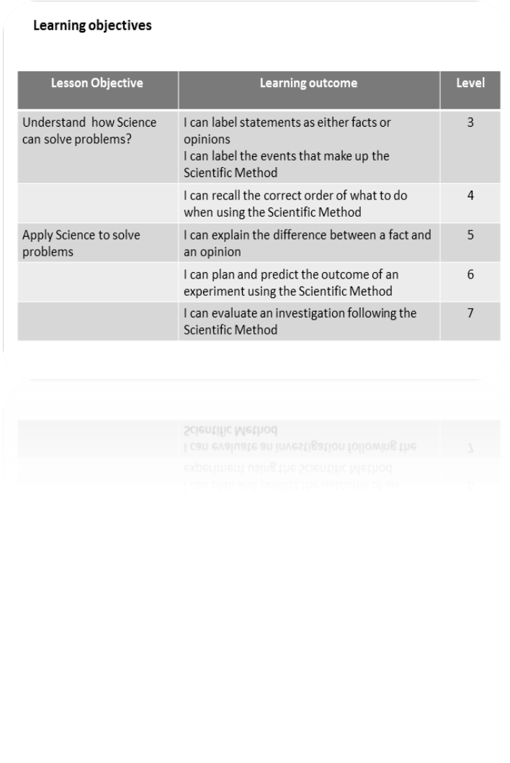
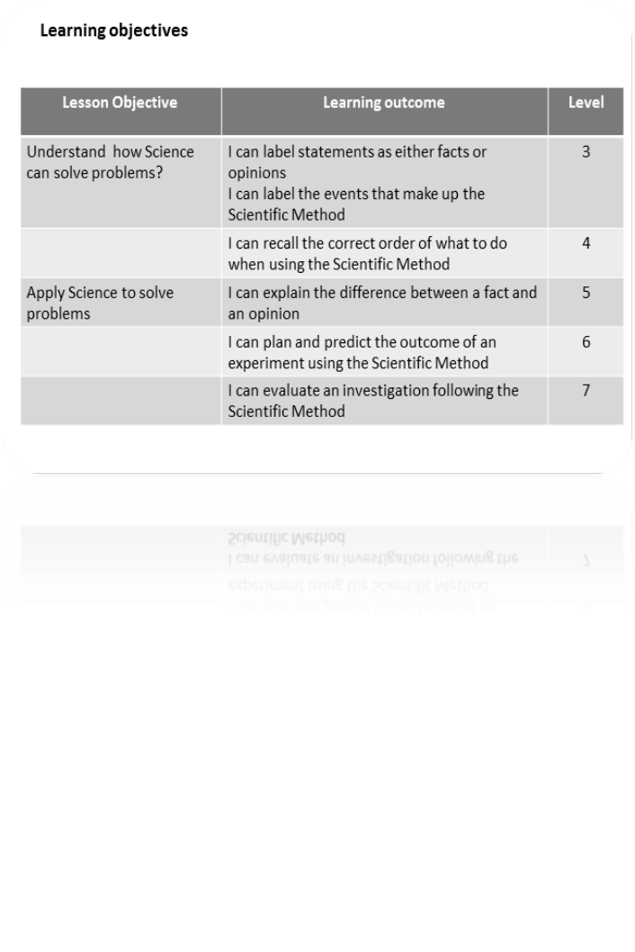
Notes:
Student copy

Slide 4
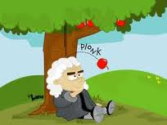
Rearrange the statements into the correct order with the correct definitions and stick into your book
Activity 1
Term | Explanation
Scientific Law | What I expect will happen
Test | A theory that fits all experimental measurements and observations
Prediction | Considering experimental data to see if your hypothesis is true or false
Hypothesis | Something that I want to provide a scientific explanation for
Analyse | An educated guess or if/then statement suggesting how something works that can be tested
Question | Conducting an experiment to test your hypothesis
Observation | How, What, When, Who, Which, Why, or Where?
Notes:
Http://www.karlkapp.com/materials/scientificMethod.swf

Slide 5
Term | Explanation
Scientific Law | What I expect will happen
Test | A theory that fits all experimental measurements and observations
Prediction | Considering experimental data to see if your hypothesis is true or false
Hypothesis | Something that I want to provide a scientific explanation for
Analyse | An educated guess or if/then statement suggesting how something works that can be tested
Question | Conducting an experiment to test your hypothesis
Observation | How, What, When, Who, Which, Why, or Where?
Term | Explanation
Scientific Law | What I expect will happen
Test | A theory that fits all experimental measurements and observations
Prediction | Considering experimental data to see if your hypothesis is true or false
Hypothesis | Something that I want to provide a scientific explanation for
Analyse | An educated guess or if/then statement suggesting how something works that can be tested
Question | Conducting an experiment to test your hypothesis
Observation | How, What, When, Who, Which, Why, or Where?
Notes:
Student copies

Slide 6

Activity 1
Answers
Term | Explanation
Observation | Something that I want to provide a scientific explanation for
Question | How, What, When, Who, Which, Why, or Where?
Hypothesis | An educated guess or if/then statement suggesting how something works that can be tested
Prediction | What I expect will happen
Test | Conducting an experiment to test your hypothesis
Analyse | Considering experimental data to see if your hypothesis is true or false
Scientific Law | A theory that fits all experimental measurements and observations
Notes:
Http://www.karlkapp.com/materials/scientificMethod.swf

Slide 7
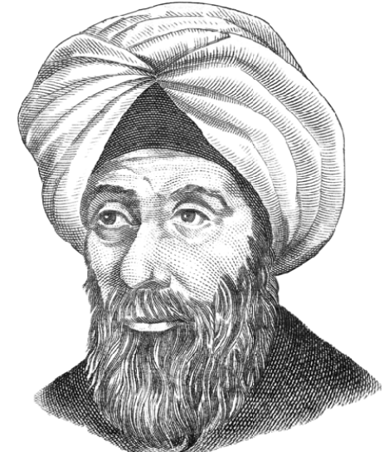
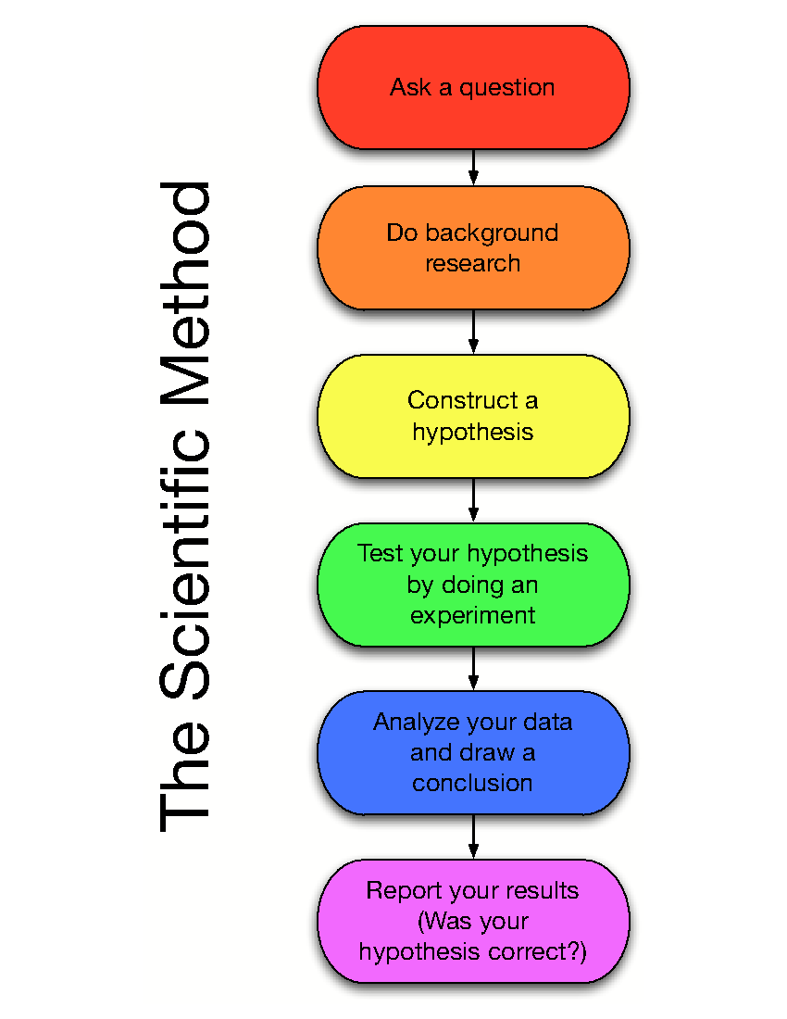
The Scientific Method
Scientists use a combination of facts (observations) to form hypotheses that can be tested by experiment to provide reliable theories and scientific laws that explain how the world works .
This process is called The Scientific Method
Observation
Ibn al-Haytham (Alhazen), 965–1039 Iraq. The Arab scholar considered to be the father of the modern scientific method
Notes:
15mins. Student notes and 5 mins sorting exercise
The scientific method is used to convert a Hypothesis into a Scientific Theory which in time will be accepted as a Scientific Law

Slide 8
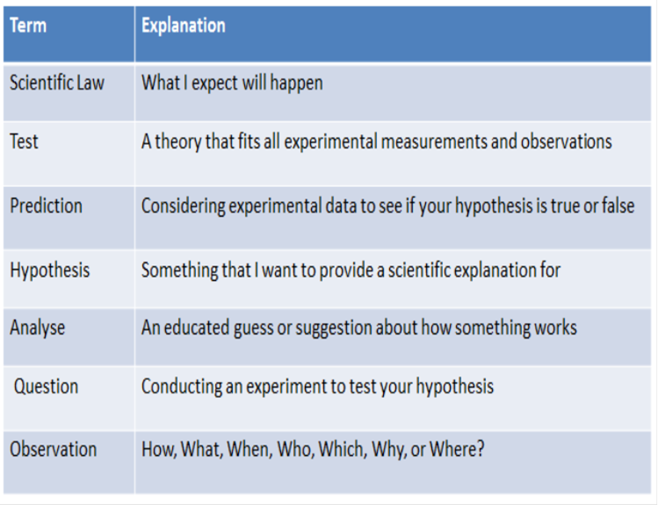


Slide 9
Find the Fib
The Scientific Method is a process used to test theories and observations
Scientists carry out tests before making up an hypothesis
The first thing a scientist does to arrive at an explanation is to make observations
The end product of the Scientific Method is to arrive at a theory
A hypothesis is a suggestion that can be tested by experiment
Notes:
5mins
Answers on mini whiteboards as teacher reads each statement. One minute to THINK on each question before raising whiteboard.

Slide 10
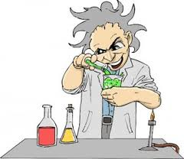
Remembering the order of The Scientific Method Activity 2
Plan your own mnemonic to help you remember the sequence of the Scientific Method
Observation | Onlynly
Question | Queens
Hypothesis | Have
Prediction | People
Test | To
Analyse | Apply
Scientific Law | Sun cream
Notes:
10mins - 5mins to do 5mins to share.

Slide 11
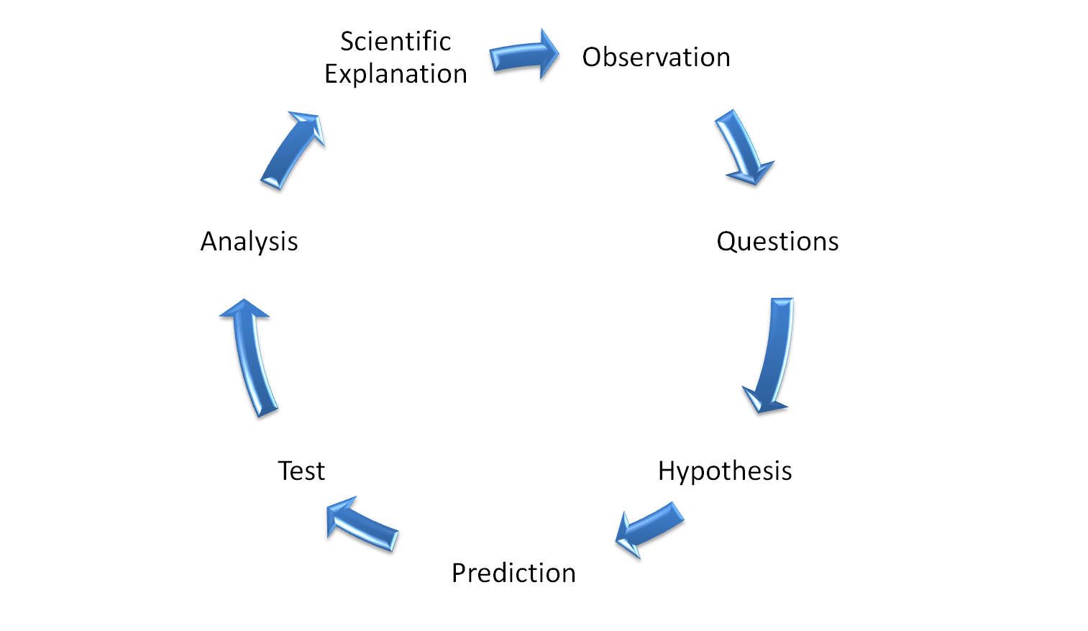
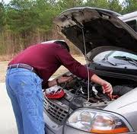
Using the Scientific Method to explain an observation
The Scientific Method helps develop ideas into scientific facts and laws
With your partner, apply the scientific method to test a hypothesis as to why your car will not start
Activity 3
My car won’t start!
Notes:
15mins – 10mins to do, 5mins to share
Observation → My car doesn't start → Ask some questions like am I out of petrol?, did I leave the lights on? Does the engine sound funny? Is the voltage too low? Is this my car? To form a hypothesis (My car does not start because the battery is flat) → I predict that if I recharge my battery that my car will start → Test = recharging the battery → Analysis = to see if car starts after recharge → Scientific Law = a car can not start with a flat battery http://www.youtube.com/watch?v=ooOfAf6X1qE
Questions you might want to ask regarding the snake:
A rattlesnakes eyes are only sensitive to visible light
A pair of organs located under the eyes detect invisible light in the form of heat
A rattler’s tongue “smells” certain odors in the air
The sight or smell of an unbitten animal does not trigger the rattler’s tracking action

Slide 12
Scientific Method Bingo
Plenary
Observe | Hypothesis
Isaac Newton | Opinion
This is the first thing a scientist does when using the scientific method to solve a problem
This is an educated guess about how something works
This scientist came up with a theory of gravitation which is now considered a scientific law
This is a statement which depends on who is making it and when it is made
Now go back to your lesson objectives and circle the level at which you think you have learnt this lesson
Observe | Hypothesis
Isaac Newton | Fact
Observe | Hypothesis
Alhazen | Fact
Observe | Prediction
Alhazen | Fact
Notes:
5mins
You could also watch this amusing Southpark clip on youtube http://www.youtube.com/watch?v=gMLHW1wU8dI
Here is a mark scheme used by a university to grade an investigation:
Scientific Paper Gradesheet:
Each of the following areas is worth two points each, for a possible total of 100 points. For each question, an answer of “yes” is worth 2 pt., an answer of “sort-of” is worth 1 pt., and an answer of “no” is worth 0 pt. For questions regarding grammar, 0 to 2 errors in that category will count as a “yes” answer, 3 to 5 errors will count as a “sort-of” answer, and over 5 will count as a “no” answer.
Initial Pages and Overall Organization: 1. Did the title accurately reflect the topic/content of the paper/experiment? 2. Were the authors’ names included on the title page? 3. Was there a Table of Contents? 4. Did the Table of Contents have correct page numbers, and were the pages numbered? 5. Overall, was the paper well-organized, were the correct sections present, and did each section have a heading? 6. Did each section contain only material appropriate to that section (no data in Methods and Materials, etc.)?
Introduction: 7. Was the hypothesis clearly stated? 8. Was the prediction clearly stated? 9. Was the prediction correctly based on and derived from the hypothesis and proposed experiment? 10. Was there an explanation of why this research is important – how does it relate to “everyday life” – of what benefit will it be to others?
Literature Review: 11. Was there evidence of a “thorough” search – were several, useful sources consulted (as per guidlines stated above)? 12. Was the author critically selective in evaluating/filtering the sources – were only legitimate, reliable sources of information used (no Web pages on “My Pet Cat, Joe”)? 13. Did the author do a good job of concisely summarizing the reported findings of others in his/her own words? 14. Were references cited where needed? 15. Was a proper citation format used (CBE, MLA, etc.)?
Methods & Materials: 16. Was the procedure clearly thought-out and stated? (in paragraph form, not a list; telling what was done, not giving orders to someone) 17. Was there a control group and an experimental group? 18. Was there repetition – more than one organism (or “peer group”) per treatment? 19. Were the data to be gathered and methods of gathering them explained? 20. Were the means of analyzing the data stated? 21. Were the needed equipment/supplies mentioned in the narrative? 22. Were supporting reasons given to justify the author’s plan?
Data: 23. Was a speculation included on what data might reasonably be found? 24. Was a valid analysis of those data done – for example, averages where needed to show effects of treatment on a test group? 25. Were the data presented concisely – no redundancy or duplication? 26. When/where feasible, were the data presented as a graph? 27. Was the type of graph appropriate to/for the type of data being represented? 28. Did the graph have a proper title, and were the axes titled and units given? 29. Did the text highlight and comment on significant data points without being redundant or duplicating the data and without drawing conclusions?
Conclusions: 30. Were conclusions drawn from the experiment that was supposedly done? 31. Were these conclusions backed up/supported by quotes of the supposed data that were collected? 32. Were the conclusions that were reached reasonable for the supposed data? 33. Were speculations on other possible experimental outcomes and the significance thereof included? 34. Were more questions and possible experimentation generated and mentioned?
Bibliography: 35. Were at least four references consulted? 36. Were at least two of those to journal articles or books? 37. Was at least one of those to a “reliable” Web site? 38. Was a correct bibliographic citation format used (CBE, MLA, etc.)?
Presentation: 39. Was the paper typed using a computer/word processor and presented in a “business-like,” professional manner (no goofy, irrelevant graphics)? 40. Were appropriate abbreviations and symbols used when needed (“m” for meters, “ ° ” for degrees, etc.), and were super- and subscripts used when needed (H₂O)? 41. Were all units/measurements given in the metric system? 42. Was the paper proofread and was a spell-checker used, if needed – was correct spelling used throughout the paper? 43. Were complete sentences used? 44. Was “-’s” used properly (“its” vs “it’s”, “cats” vs “cat’s” vs “cats’,” etc.)? 45. Was there verb tense agreement throughout the paper? 46. Was there singular/plural agreement throughout the paper, especially among personal pronouns (“he/she” vs “they”)? 47. Were various “sound-alike” words used properly (there, their, they’re, to, too, two, etc.)?
Overall Effort & Thought: 48. Was there sufficient evidence of effort expended? 49. Was there evidence that the author used insight, thoughtfulness, and critical thinking when writing the paper? 50. Was the paper in on time?

Slide 13
Activity 4 should be for another lesson

Slide 14
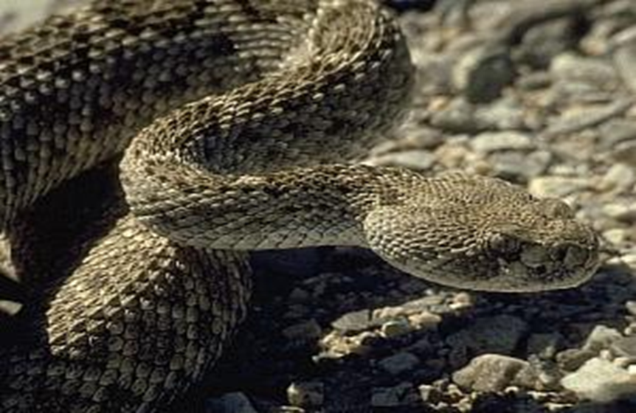
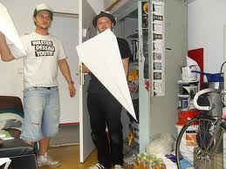
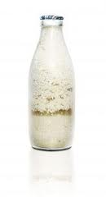

Using the Scientific Method to explain an observation
The Scientific Method helps turn scientific theories into scientific facts and laws
With your partner, apply the scientific method to test any one of the following observations: OQHPTAS
Activity 4
Rattle snakes seem to follow an invisible trail to their prey after it has been bitten | Aeroplanes with the biggest wings travel the furthest
Milk goes bad quickly if left in an open container | Meat turns into maggots if left in the open
Notes:
15mins – 10mins to do, 5mins to share
Observation → My car doesn't start → Ask some questions like am I out of petrol?, did I leave the lights on? Does the engine sound funny? Is the voltage too low? Is this my car? To form a hypothesis (My car does not start because the battery is flat) → I predict that if I recharge my battery that my car will start → Test = recharging the battery → Analysis = to see if car starts after recharge → Scientific Law = a car can not start with a flat battery
Questions you might want to ask regarding the snake:
A rattlesnakes eyes are only sensitive to visible light
A pair of organs located under the eyes detect invisible light in the form of heat
A rattler’s tongue “smells” certain odors in the air
The sight or smell of an unbitten animal does not trigger the rattler’s tracking action

Slide 15
End http://www.youtube.com/watch?v=EYPapE-3FRw
Notes:
For an amusing discussion on SM see Richard Feynman’s lecture http://www.youtube.com/watch?v=EYPapE-3FRw

Slide 16
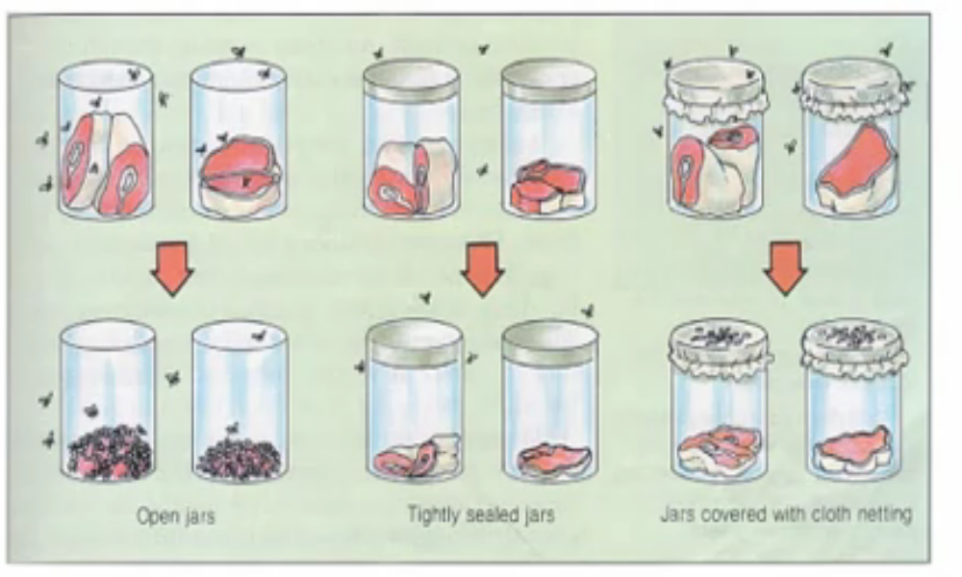
Redi’s investigation into spontaneous generation

